Slide 1

.crash course
Christina Protopapadaki, Filip Jorissen, Bram van der Heijde & Iago Cupeiro Figueroa
Christina.Protopapadaki@bwk.kuleuven.be Filip.Jorissen@mech.kuleuven.be,
Bram.vanderHeijde@kuleuven.be
Iago.cupeirofigueroa@kuleuven.be
May 3rd, 2017
Notes:
This course is for YOU. We can drive the course towards your needs, or what you think it is better for you.

Slide 2
Modelica crash course
What is Modelica ?
Syntax, language concepts and model structuring
Modelica tools
Use of IDEAS library
Getting started (tutorials, reference docs, libraries, software implementations, ...)
➔ To get you started with Modelica!

Slide 3
 | Agenda
11:00 - 11:30 | What is modelica? How does it work?
11:30 - 11:45 | What is Dymola and how does it work? Where to find information?
11:45 – 12:00 | Coffee break & Licence activation (in case)
12:00 – 12:45 | Basic modelica exercise
12:45 - 13:45 | LUNCH BREAK
13:45 - 14:15 | What is IDEAS?
14:15 - 17:30 | IDEAS guided building model

Slide 4
What is Modelica?

Slide 5
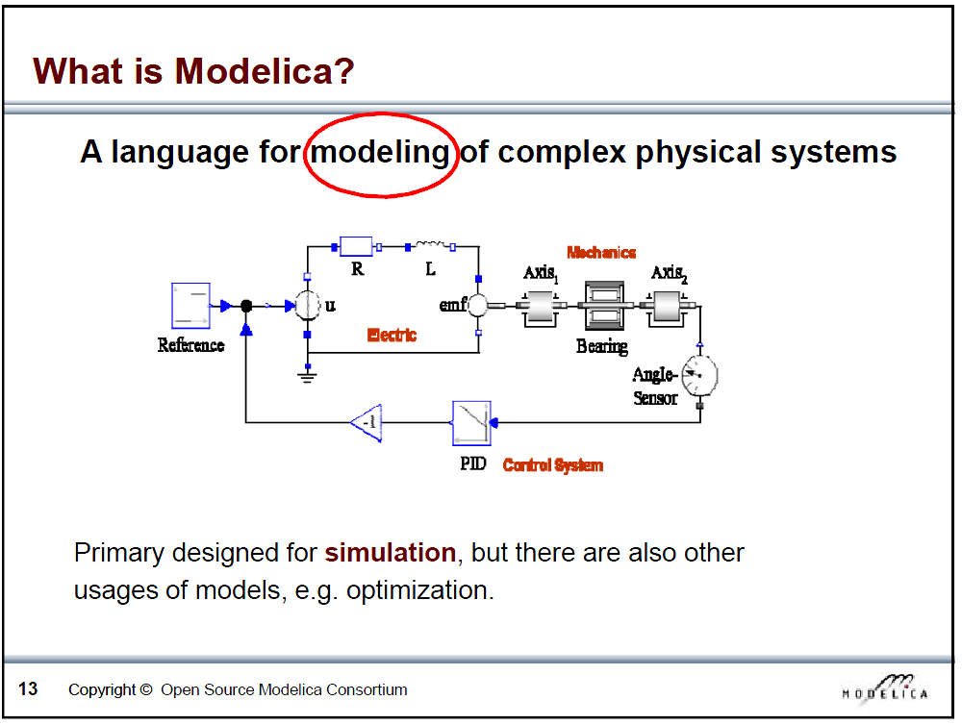
Slide from Peter Fritzson, Introduction to Object-Oriented Modeling, Simulation and Control with Modelica, Tutorial for Modelica Conference 2011, Dresden
Notes:
Modelica is a language for modeling complex physical systems
Model – a representation of the reality with equations

Slide 6
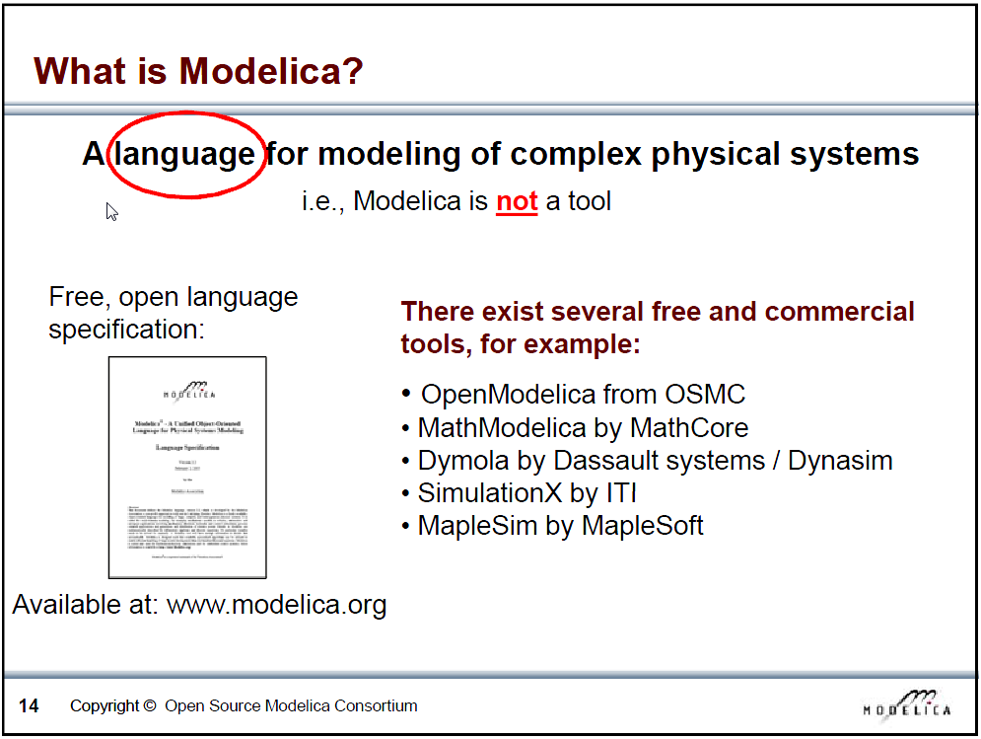
Slide from Peter Fritzson, Introduction to Object-Oriented Modeling, Simulation and Control with Modelica, Tutorial for Modelica Conference 2011, Dresden
Notes:
Modelica is a LANGUAGE!!!! – Important
Tools that work using this language – Dymola, Openmodelica...

Slide 7
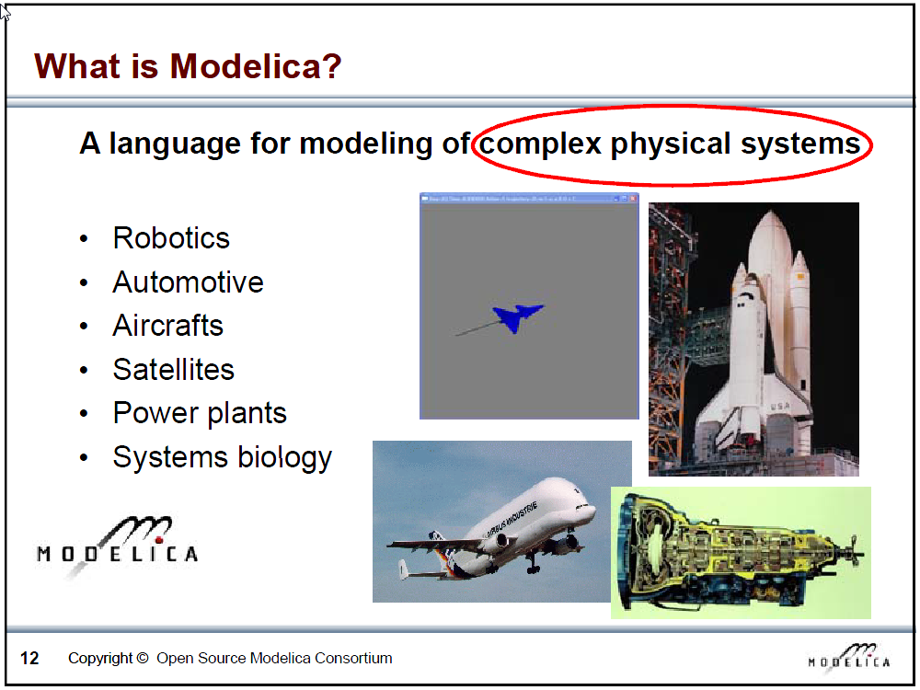
Slide from Peter Fritzson, Introduction to Object-Oriented Modeling, Simulation and Control with Modelica, Tutorial for Modelica Conference 2011, Dresden
Notes:
In Modelica Standard Library we can find Mechanical, Electrical, Thermal... components

Slide 8
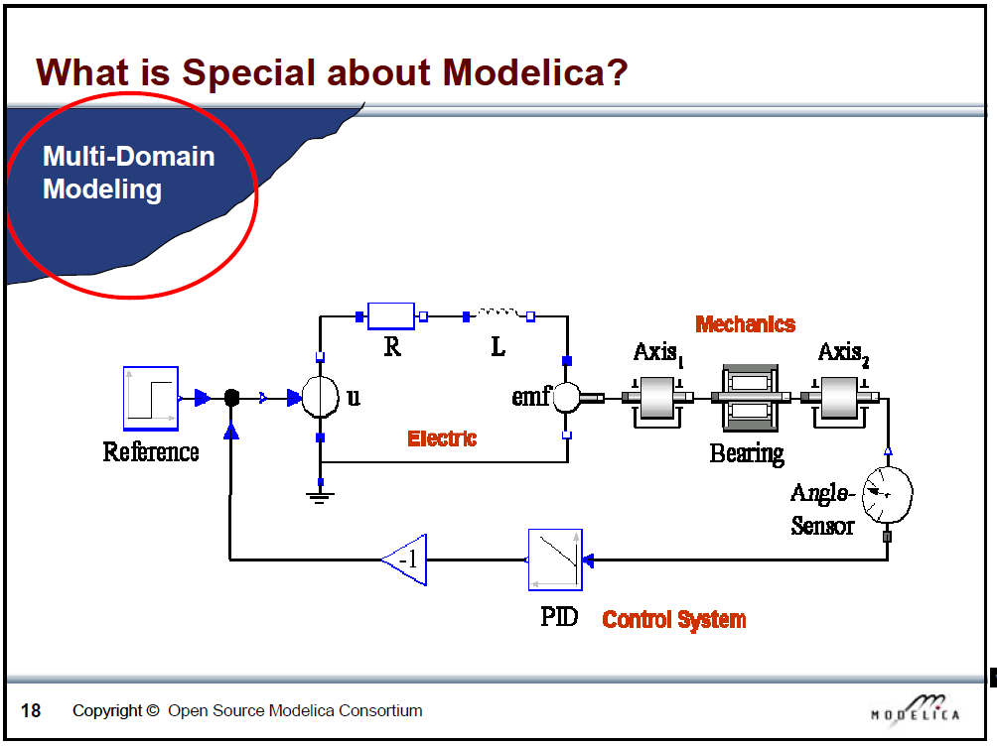
Slide from Peter Fritzson, Introduction to Object-Oriented Modeling, Simulation and Control with Modelica, Tutorial for Modelica Conference 2011, Dresden

Slide 9
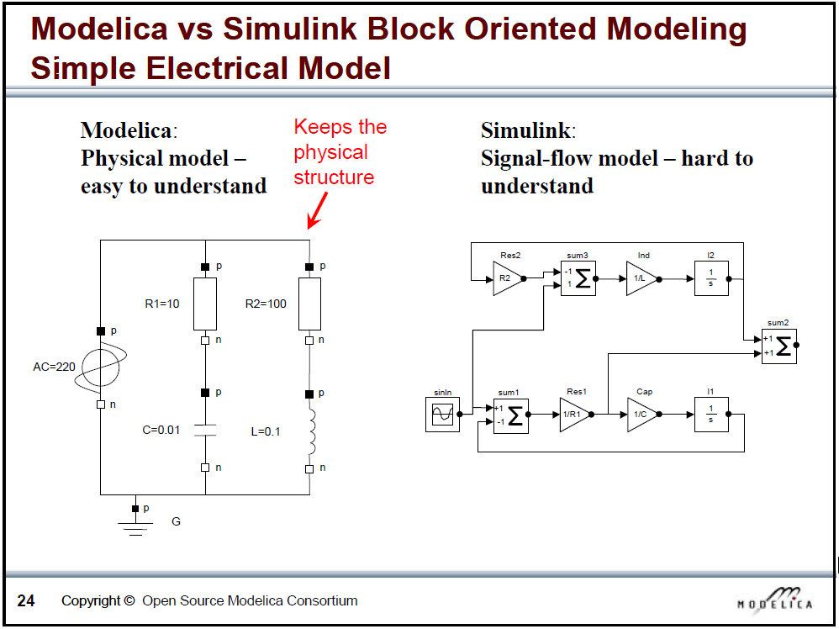
Slide from Peter Fritzson, Introduction to Object-Oriented Modeling, Simulation and Control with Modelica, Tutorial for Modelica Conference 2011, Dresden
Notes:
A-causal modeling: Declarative languages just require the developer to define the problem at a higher level and leaves the solution to the simulation tool
Block-oriented modeling: Procedural programs require the developer to define the order that calculations are to be done in

Slide 10

What is Modelica
Modelica is a language for modeling of physical systems
open source
object oriented
Acausal modeling (equation based)
multi-domain
primarily for simulation, but usable for optimization
small and large models (> 100 000 equations)
many model libraries (free and commercial)
textual and graphical modeling
Notes:
A-causal modeling: Declarative languages just require the developer to define the problem at a higher level and leaves the solution to the simulation tool
Block-oriented modeling: Procedural programs require the developer to define the order that calculations are to be done in

Slide 11
How does Modelica work?

Slide 12
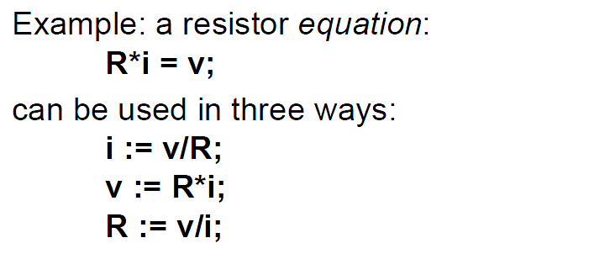
Equations
Arithmetic operators
*, /, +, -, ^ (use . for element-wise)
Derivatives
der(x) = x ~
Slide from Peter Fritzson, Introduction to Object-Oriented Modeling, Simulation and Control with Modelica, Tutorial for Modelica Conference 2011, Dresden
Notes:
Modelica is a programming language. Overview of the most important parts of the syntax

Slide 13
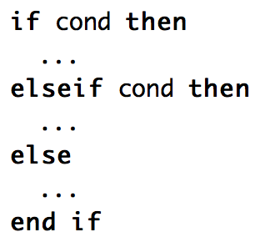

Logical operators, control flow
Logical
and, or, not
Conditional
If, elseif, else
Loops
For
Comparing numbers
>, <, <>, >=,…

Slide 14
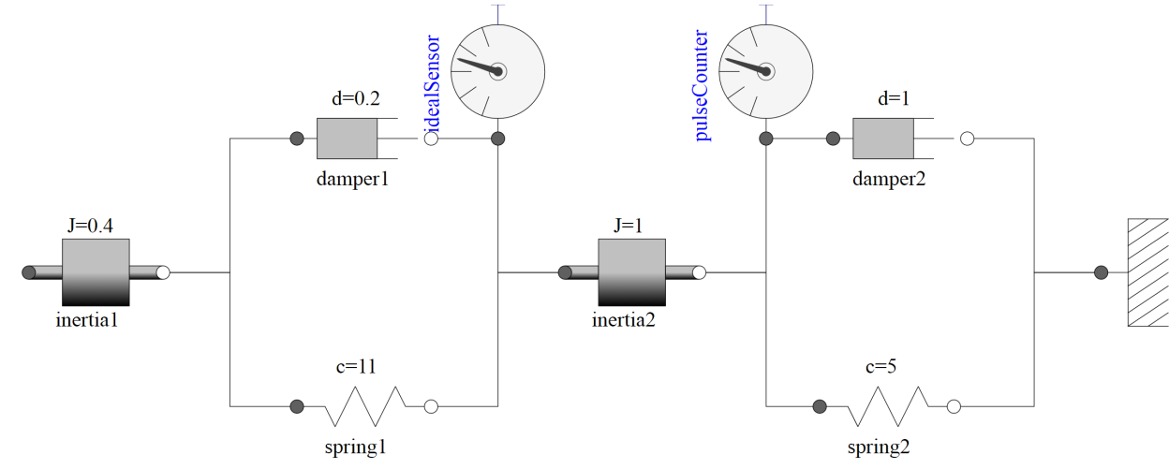
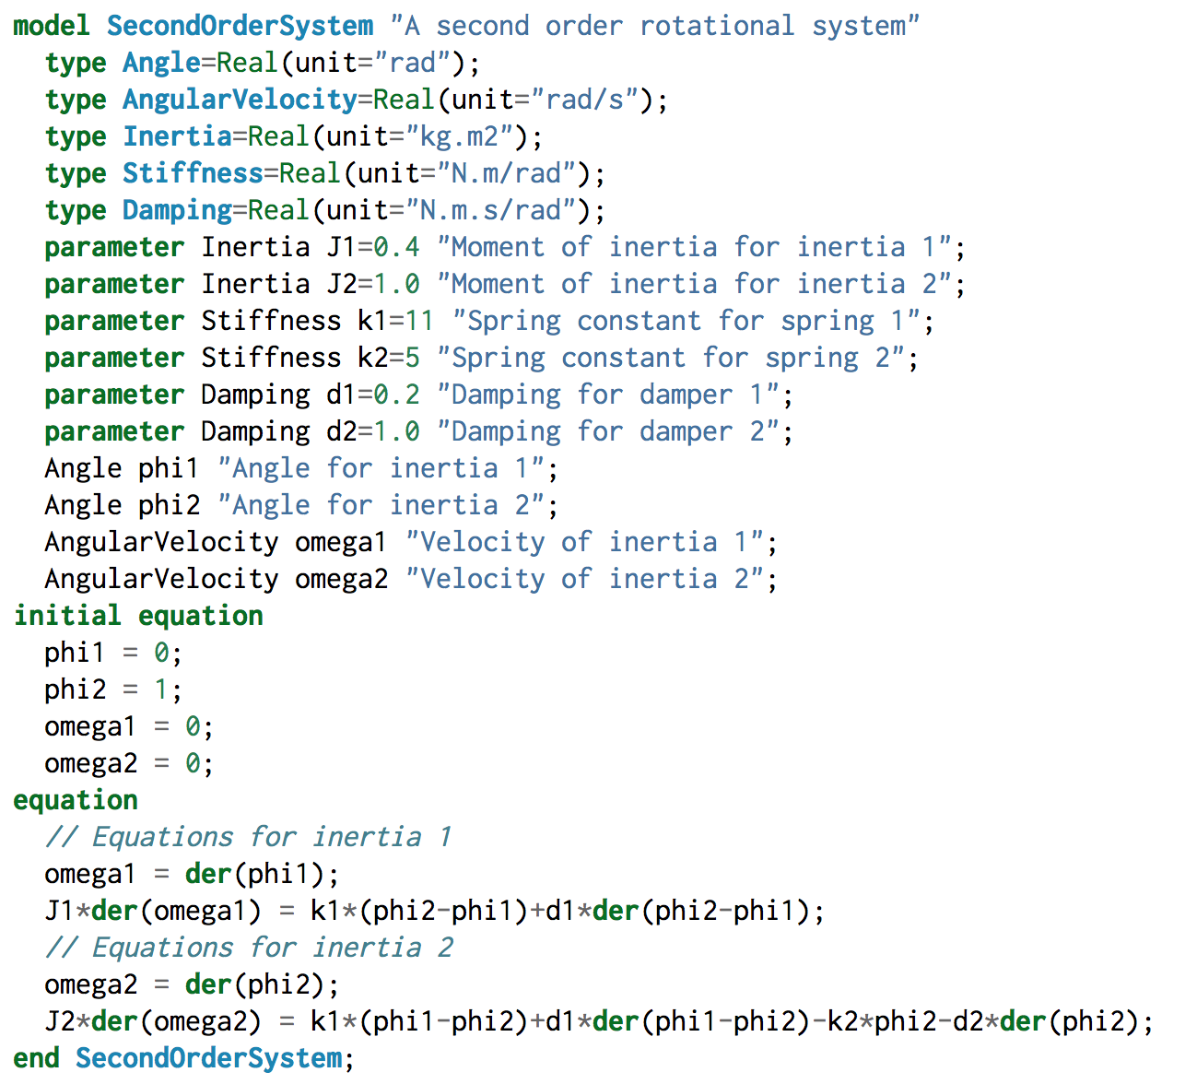
Models
# variables = # equations!
Balanced
Close line with ;
From M. Tiller, Modelica by Example, http://book.xogeny.com
Notes:
A lot of types defined in the Modelica standard library Modelica.SIunits.Type

Slide 15
Comments
Very important!
Comments regarding components, parameters, variables
“this is a comment”
Can show up in graphical interface
Line comments
// This is a comment on one line
/* This is a comment over multiple lines */

Slide 16
Slide from Peter Fritzson, Introduction to Object-Oriented Modeling, Simulation and Control with Modelica, Tutorial for Modelica Conference 2011, Dresden
Notes:
We cannot connect, for example, an electrical line with a heat flow

Slide 17
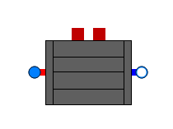
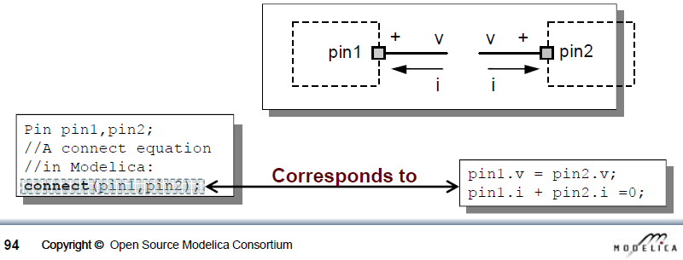
Connectors
Usually
Signal in out
Fluid flow (mass flow rate, pressure, enthalpy)
Heat flow (heat flow rate, temperature)
flow variable, potential variable
Slide from Peter Fritzson, Introduction to Object-Oriented Modeling, Simulation and Control with Modelica, Tutorial for Modelica Conference 2011, Dresden
Notes:
Electrical: flow variable is current, potential variable is voltage
Mechanical: flow variable is force, potential variable is position
Thermal: flow variable is heat flow, potential variable is temperature
Connect two components is equal as applying Kirchoff equations

Slide 18
Components
Instances of a model
model name usually Capitalized, instance not
Wall innerWall(res = 200, A = 10);
public variables and parameters can be accessed with dot notation, e.g.:
heatPort.Qflow
wall.res
Protected variables/params cannot be accessed
Don’t show up in simulation results
Notes:
When we have a model defined, we can drag that model as a subcomponent to other model as an instance
When defining variables and parameters, you can state a protected paragraph

Slide 19
Inheritance
Model inherits from other model
Variables, parameters, equations
extends keyword
partial model
Code can be managed more easily
Example
Notes:
With partial model we define a model that is not completed, thus when extending it will need some extra information

Slide 20
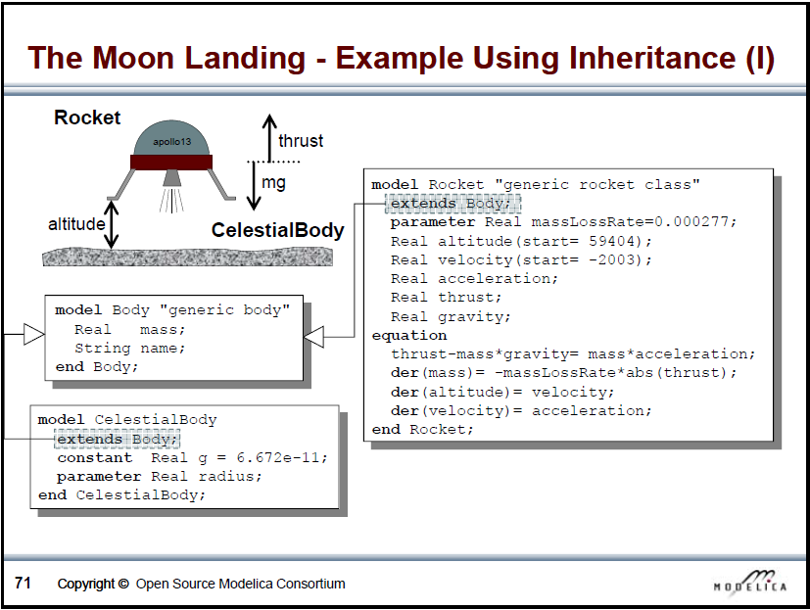
Slide from Peter Fritzson, Introduction to Object-Oriented Modeling, Simulation and Control with Modelica, Tutorial for Modelica Conference 2011, Dresden
Notes:
For CelestialBody we will need equations for mass, name and radius
For Rocket we will need 3 more equations: name, thrust and gravity

Slide 21
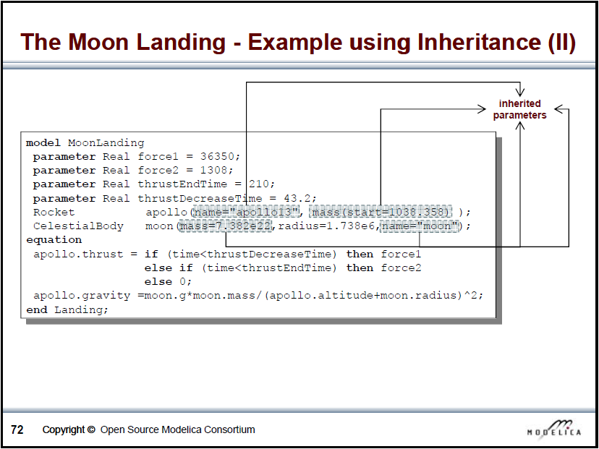
Slide from Peter Fritzson, Introduction to Object-Oriented Modeling, Simulation and Control with Modelica, Tutorial for Modelica Conference 2011, Dresden
Notes:
In moond landing we define the remaining parameters: both names, and thrust and gravity for Rocket
Notice the dot notation

Slide 22
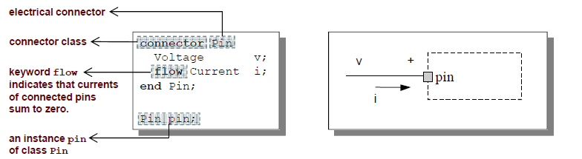
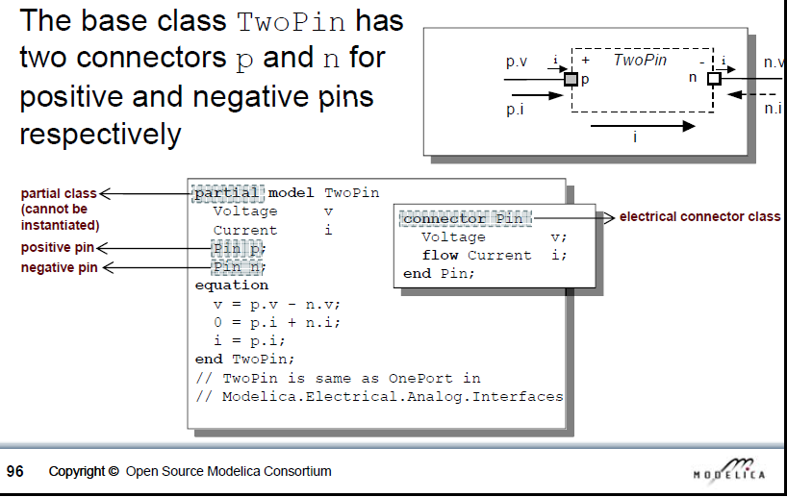
Inheritance and connectors
Slides from Peter Fritzson, Introduction to Object-Oriented Modeling, Simulation and Control with Modelica, Tutorial for Modelica Conference 2011, Dresden
Notes:
Another example of inheritance

Slide 23
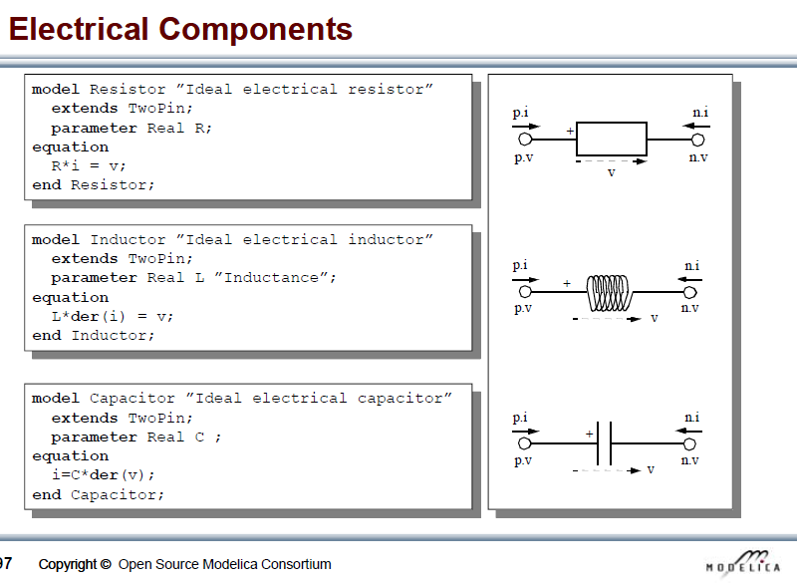
Slide from Peter Fritzson, Introduction to Object-Oriented Modeling, Simulation and Control with Modelica, Tutorial for Modelica Conference 2011, Dresden
Notes:
Good code management

Slide 24
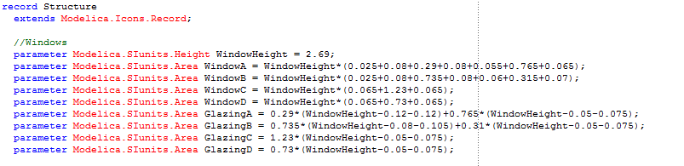
Records
Data records can be created to collect parameter information regarding a model
Pros
Keep data separate from models
Easy model parametrization with drop-down list
Easy to see what data is used in a particular model
Notes:
This records can be instantiated in the model so that you can refer them afterwards with the dot notation

Slide 25
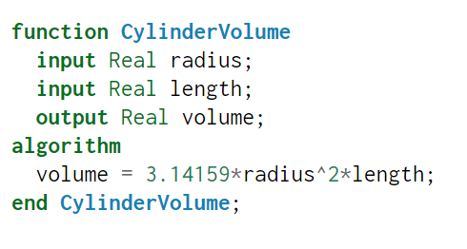

Functions
Modelica also allows the creation of functions
Calling the function
It is possible to have several outputs
Notes:
It is also possible to create your own functions for later code use
Define inputs and outputs

Slide 26
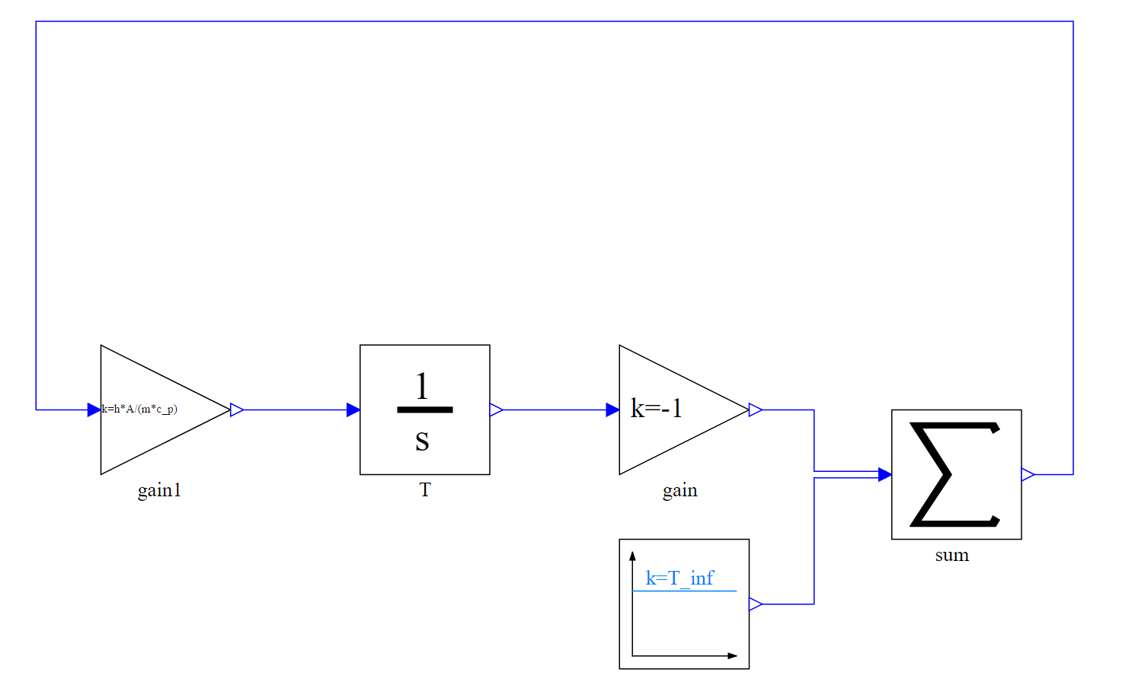
Blocks
For causal formalisms
Used in control systems
Picture from http://book.xogeny.com/components/components/block_comps/
Notes:
Modelica also have a series of blocks for causal modelling, used in the control systems

Slide 27
How does Dymola work?

Slide 28
Modelica environments
Commercial software tools
Dymola (Dassault Systèmes, Sweden)
MathModelica (MathCore, Sweden)
SimulationX (ITI, Germany)
MapleSim (Maplesoft, Canada)
Free and open source tools
OpenModelica (Open Source Modelica Consortium, Sweden and other countries)
JModelica (Modelon, Sweden)

Slide 29
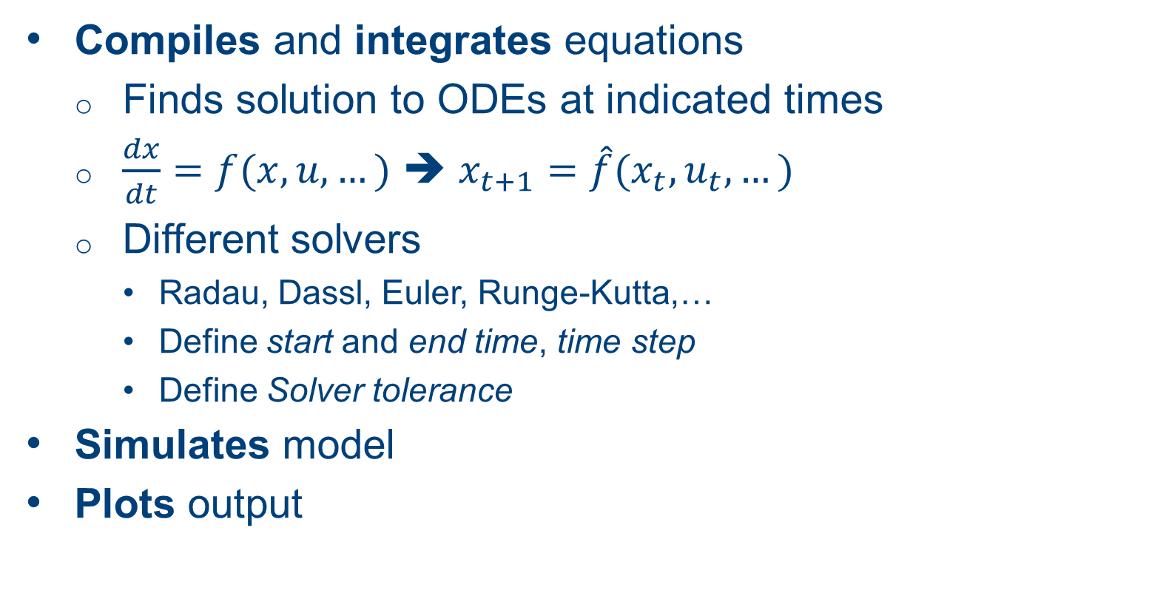
What does Dymola do?
Compiles and integrates equations
Finds solution to ODEs at indicated times
$\frac{dx}{dt}=f(x,u,…)$ ➔ $x_{t+1}=\hat{f}(x_{t},u_{t},…)$
Different solvers
Radau, Dassl, Euler, Runge-Kutta,…
Define start and end time, time step
Define Solver tolerance
Simulates model
Plots output
Notes:
No optimization

Slide 30
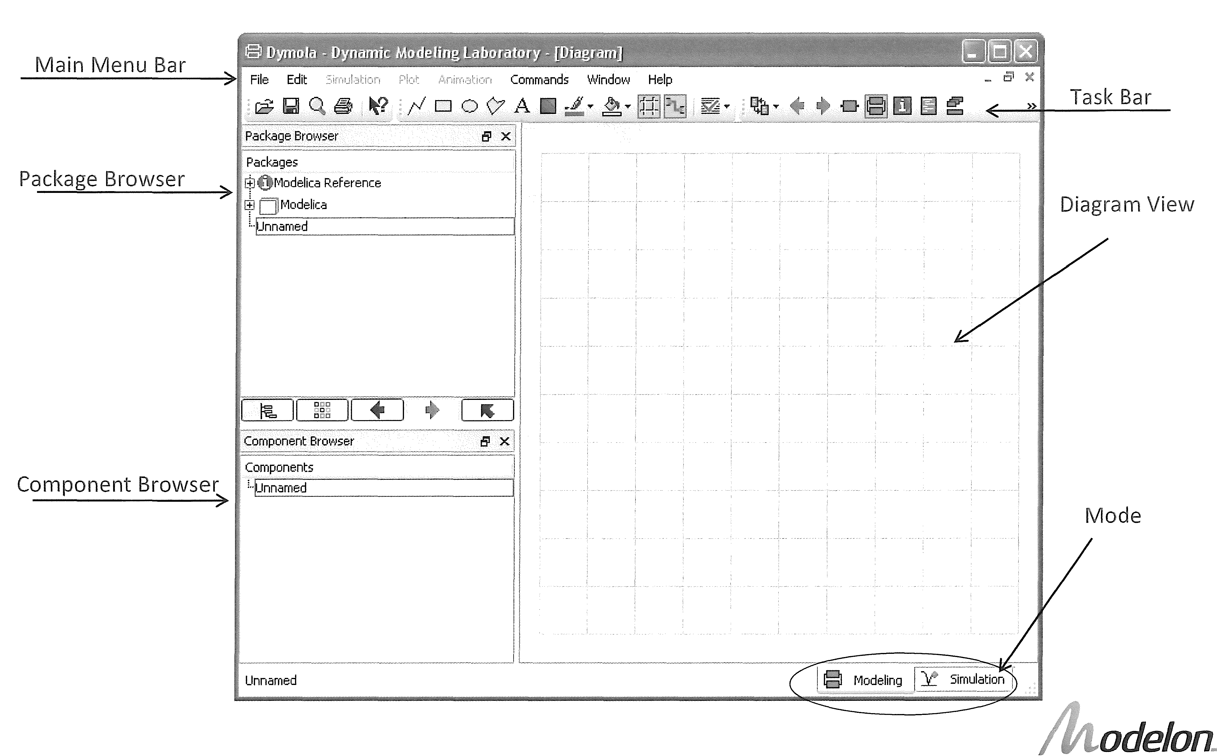
Graphical user interface

Slide 31
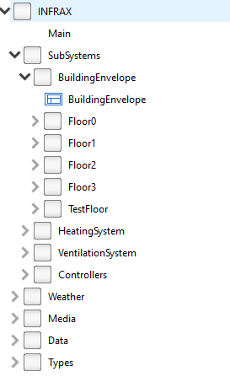
Packages
Packages are a way to organize models in a structured way
Hierarchical structure
Any number of levels can be defined
A way to group models of similar type in one place
Easy to find a particular model

Slide 32
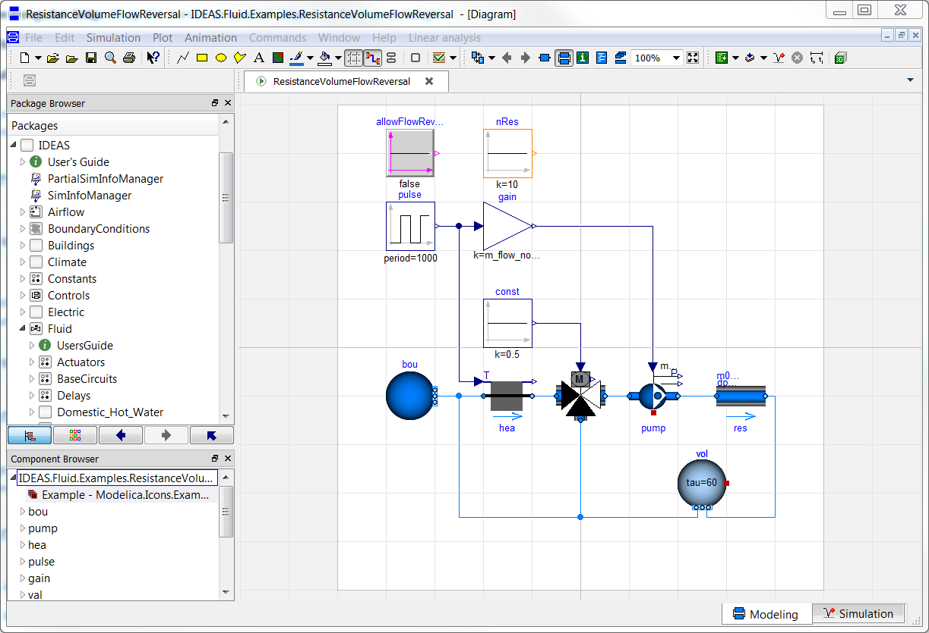
Graphical user interface
Notes:
Use check constantly

Slide 33
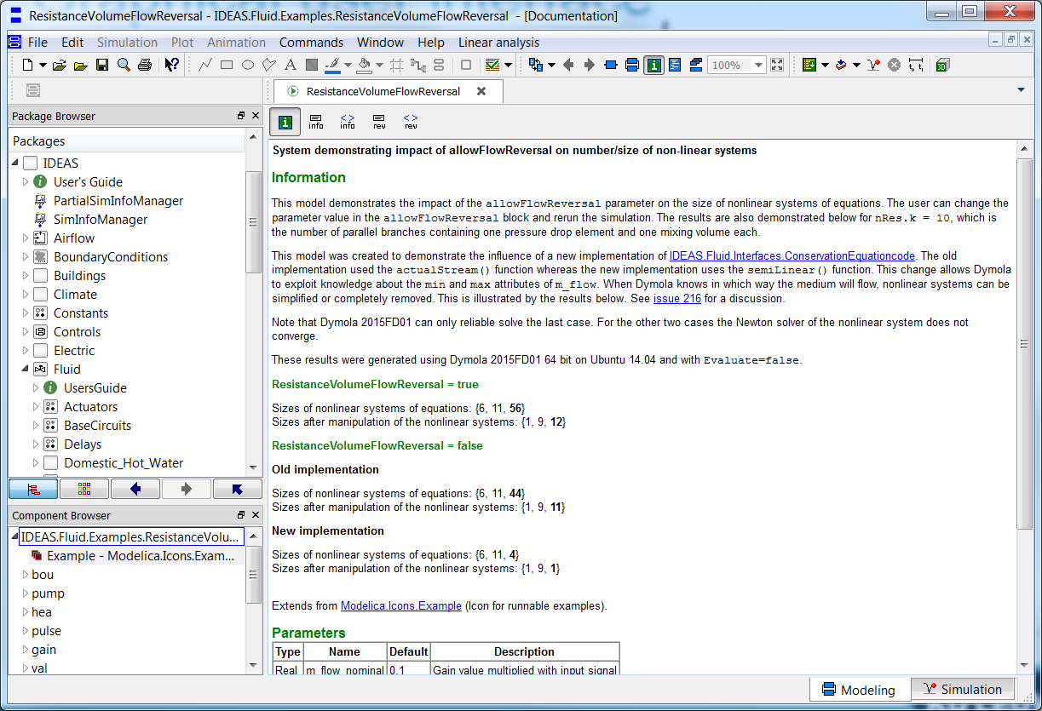
Graphical user interface

Slide 34
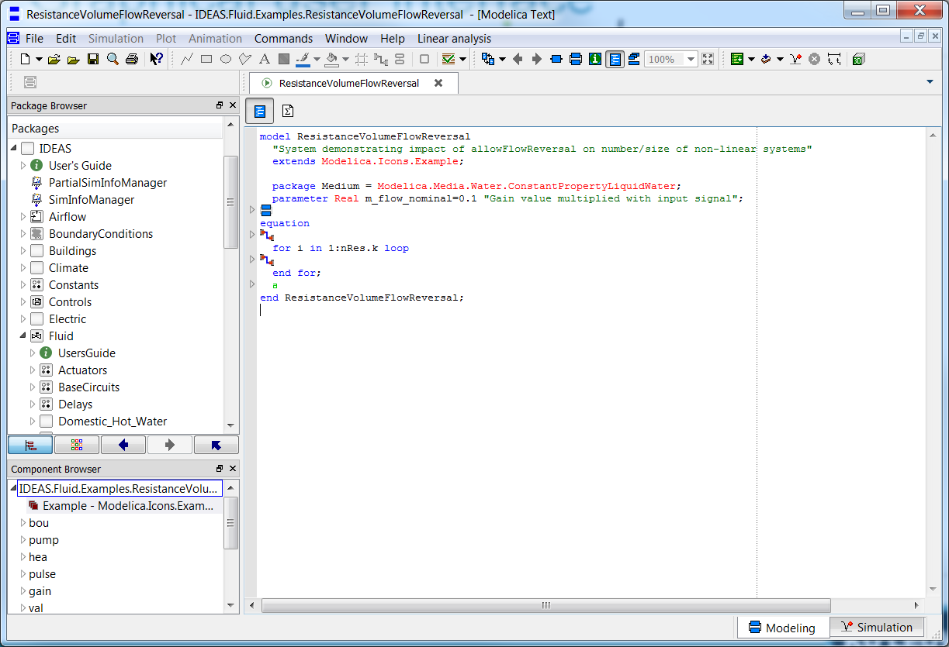
Graphical user interface

Slide 35
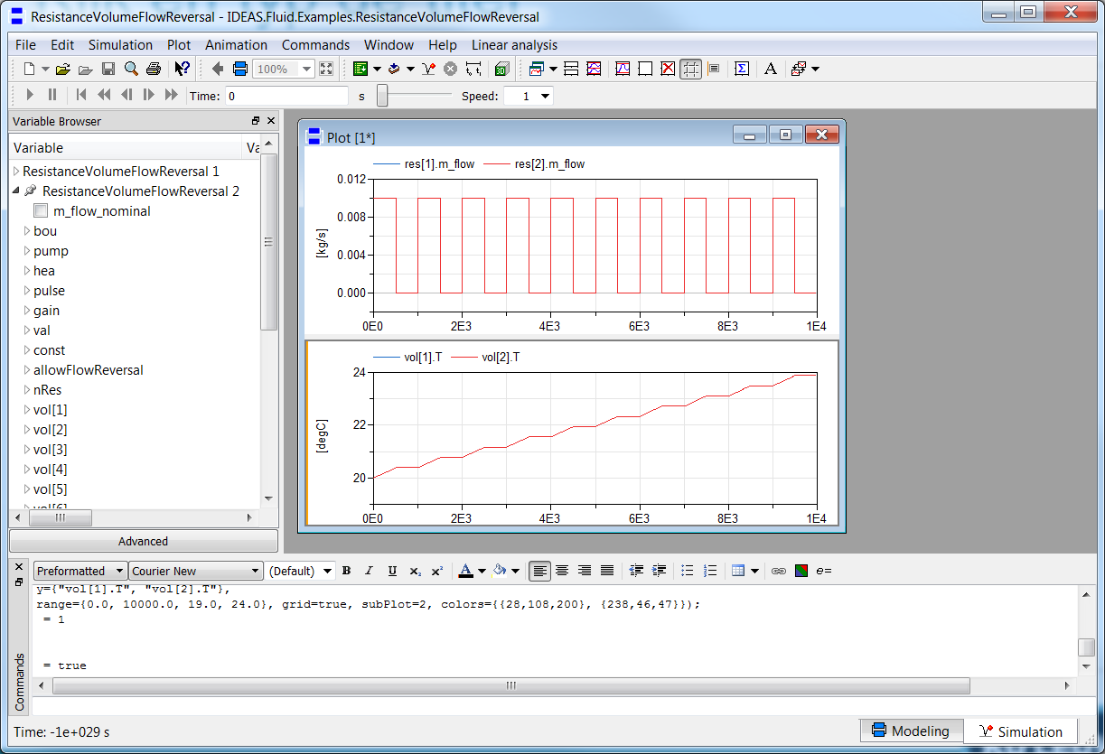
Graphical user interface
Task Bar
Main Menu Bar
Plot Diagrams
Variable Browser
Command Shell

Slide 36
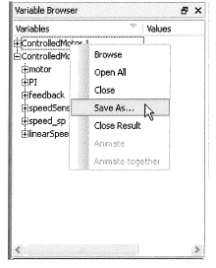
Exporting results
All results in the Variable Browser can be exported
To export a result, right-click the name of the result and select Save As…
There are several formats to which the result can be saved
.mat (Matlab format can also be opened in Dymola)
.csv (for use in e.g. Excel)
.txt

Slide 37
Interface with other programs
Scripting
Parameter variation
Parallel simulations
Optimal control
Python scripts using BuildingsPy
Nice for plotting
http://simulationresearch.lbl.gov/modelica/buildingspy/
MATLAB
Built-in with Dymola

Slide 38
Websites
General
www.modelica.org
www.openmodelica.org
www.jmodelica.org
http://www.claytex.com/tech-blog/
Modelica language
http://modref.xogeny.com/ !!!
http://book.xogeny.com/ !!!
KUL modeling conventions
https://docs.google.com/document/d/1MaNKTdLz-YPpEEH3Eg12ECzG0ErK-rIK9IHd6gsBp7Q/edit?usp=sharing
Libraries:
https://github.com/open-ideas --> IDEAS + Crash Course
https://simulationresearch.lbl.gov/modelica --> look at Buildings.Examples.Tutorial
Annex 60: https://github.com/iea-annex60/modelica-annex60
Dymola user guide
Volume 1 & 2: C:\Program Files (x86)\Dymola 2017\Documentation\Dymola User Manual Volume 1 or via Dymola > help.

Slide 39
Fora
http://www.openmodelica.org/index.php/forum
http://www.jmodelica.org/forum
www.stackoverflow.com (tag Modelica)
And last but not least: https://groups.google.com/d/forum/modelicans

Slide 40
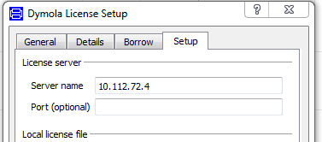
Use of Dymola with KULeuven license
Access to a floating licence (on the building physics server).
Connected physically (cable) to the building physics or mech network
Open Dymola and go to help>licence..
Enter 10.112.72.4 and follow instructions
More information on Modelicans (google groups)

Slide 41
Break
Time to activate and borrow your license!

